Slide 1

SMART GRADER
FALL 2021 CAPSTONE PROJECT | DELIVERABLE-2
GUIDED BY-PROF.HENRY WONG

Slide 2

Team Members
AKANKSHYA BISWAL
EMI HARRY
GIO ABOU JAOUDE
JONATHAN ANGAMARCA
JOSEPH DOUGAL
JOSE SALCEDO
RITHVIK SUBRAMANYA
TJ RABBANI

Slide 3

Agenda
Overview
Minimal Viable Product
User Stories
Acceptance Criteria
Mock-Up Designs
Test Cases
Sprint Backlog
Product Backlog
Milestone Timelines
Retrospectives
Future Tasks
Conclusion
Notes:
Project Description and Project Components
Technologies used in the project
Market Analysis
User personas
Milestone timeline
Retrospective: things that worked

Slide 4
Overview
Smart Grader would not only allow the students to solve their assignments on time and the teachers to grade their students online but also would allow the parents and the head of organization to keep a track of their children/student's academic progress.
During the COVID-19 pandemic students had to do their classes online. With more online classes they were piled up with more assignments and projects.
Even teachers had to face a lot of challenges during this pandemic by not only teaching the students online but also checking their assignments and exams online.
Parents and even the department head of all the organizations had issue of keeping a track on their children/student's academic progress.
Notes:
Smart Grader is a website with tools to generate and grade assignments, with different views users based on how they interact with the homework. The website will not only allow the scoring of mathematically based questions, as is current industry standard, but with NLP will also allow the generation and scoring of text-based questions/answers.
Depending on the scope and success of the deliverables, more and more macro tools will be layered on top of the product. This will allow for more user personas, such as educational organizations and/or parents.
The product may also include a paywall for various features.

Slide 5

Minimal Viable Product(MVP)
Notes:
Standard:
The website will be password encrypted for all users with basic website properties like create new account, forgot password, etc.
The website will allow for different user type accounts like students, teachers etc.
The website will direct students to homework given by their teachers.
The website will grade mathematical questions proposed by their teachers.
The website will alert students and teachers to homeworks being posted and submitted, with timestamps.
Novel:
The website will offer a feature that may direct students to parts of their textbook/class text that corresponds to a question they are being asked.
The website will check the correlation between an answer submitted by a student and an answer submitted by a teacher, in order to grade that student answer.
The website will check grammatical and structural aspects of a student's answer to propose suggestions that improve upon those aspects. It is important that the substance and the validity of the answer not be altered to validate/invalidate that answer.

Slide 6
STEP1
Login as an Educators/Students/Others.
If the user is an Educator, they can post the questions and the answers for the questions to review.
If the user is a student, go to the assignment page and click on the 'take me to the text' button, which will take you to the textbook pages, where you will most likely find the answers.
For Others(Teachers/Organization they can review their children/Students academic progress.
STEP2
STEP3
For Teachers, after each student submits the assignment, they will get a notification. They can go to the assignment page and click on the 'verify' button, which will give them the score for each student.
Students will get a notification once the teachers have posted the assignments, and then they can write the answers and submit them.
STEP4
Teachers can randomly review any student's answers to verify, and students can check their assignments after they have received grades from teachers and logout from the application.

Slide 7

User Stories
This Photo by Unknown author is licensed under CC BY-SA.

Slide 8

User Stories
USER ID​ | USER TYPE​ | I WANT TO​ | SO THAT​
USR1​ | Student​ | Explore the website.​ | I can see the new and old assignments. ​
USR5​ | Student​ | Create an account.​ | I can input my questions.​ ​
USR20​ | Student​ | Enter my personal information safely.​ | I can have privacy. ​ ​
USR12​ | Student​ | Interact with the website.​ | I can find questions related to the same topic. ​
USR6​ | Student​ | Comment on some answers.​ | I can help other users. ​ ​

Slide 9
User Stories
USER ID​ | USER TYPE​ | I WANT TO​ | SO THAT​
USR9​ ​ | Student​ | Get notification of the possible vulnerabilities.​ | I can update my password.​ ​
USR2​ | Teacher​ | Explore the website.​ | I can find old questions.​
USR17​ | Teacher​ ​ | Sign up for the website.​ | I can find relevant questions for my tests.​
USR12​ | Teacher​ ​ | Upload some reference questions.​ | Students can prepare for tests.​ ​
USR16​ | Teacher​ | Upload papers.​ | The system can grade them for me.​ ​
USR8​ | Teacher​ | Create a profile for different accounts.​ | I can group questions by topic.​ ​

Slide 10
User Stories
USER ID​ | USER TYPE​ | I WANT TO​ | SO THAT​
USR3​ | Teacher​ | Store grades.​ | I can have an idea of my class performance.​ ​
USR18​ | Teacher​ | Export grades.​ | I can create a report. ​ ​
USR14​ | Teacher​ | Get notification of possible vulnerabilities.​ | I can update my password. ​ ​
USR11​ | Head of Math Dept.​ | Explore the website.​ | I can see how many of my classes are using it.​ ​
USR4​ | Head of Math Dept.​ | View results from classes on the website in my department.​ | I can track the student record.​

Slide 11
User Stories
USER ID​ | USER TYPE​ | I WANT TO​ | SO THAT​
USR10​ | Head of Math Dept.​ | Get notified of possible vulnerabilities.​ | I can update my password.​ ​
USR15​ | Working Parent​ | Explore the website. ​ | I can see my child's new and old assignments.​ ​
USR19​ | Working ​ Parent​ | See the history of grades of my child. ​ | I can see which questions my child is struggling with.​ ​
USR13​ | Working ​ Parent​ | Get notified of possible vulnerabilities.​ | I can update my password.​ ​

Slide 12

Acceptance Criteria

Slide 13

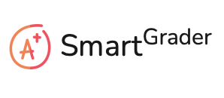
Acceptance Criteria for Homepage
ACCEPTANCE CRITERIA
The homepage of Smart Grader would display its logo with the login page.
The page would also allow different users(i.e., Student, Educators, Others) to create an account in Smart Grader.
The login page would allow existing users to log in to the application or reset their password(if they have forgotten the password) and new users to create an account for Smart Grader.

Slide 14
Acceptance for Input Page
ACCEPTANCE CRITERIA
After the users have logged in to the Smart grader, they would be allowed to perform various tasks based on their account type.
Teachers would be able to insert the questions for the assignment and upload the pdf/file related to the context of the questions. They would also type in the answers to the question to allow Smart grader to grade their responses based on that.
Students would be able to open the new assignments posted by their teachers, and they can either solve them by themselves or request for 'take me to the text,' which would direct them to the page where they would most probably find the answers to their question.
Parents/heads of a department can give the children/students' names, search for their graded test papers, and go through them.

Slide 15
Acceptance for Input Page
ACCEPTANCE CRITERIA
Teachers can also review any student's assignment by searching by their name.
Students would not be able to review any other student's assignment but can check their previous grades and progress.
Teachers will be able to upload any textbook pdf or notes for their students to refer for the assignment.

Slide 16
Acceptance for Result Page
ACCEPTANCE CRITERIA
Teachers would be able to receive a notification once a student has submitted the answers for the assignment with the grades imputed by Smart Grader. They can then verify(if required) and send it to the student.
Students would be able to solve the questions quickly and would also get notification once the teacher has sent them the grades.
Parents will get notification once their children have received any new grades from any assignments posted through Smart Grader.
Once the grading is done, head of any dept. Can review the grading system as well as the level of questions posted by teachers by searching for any student's academic report.

Slide 17
Acceptance for Result Page
ACCEPTANCE CRITERIA
Teachers can review any student's performance by using 'Generate Report' for the student.
Parents can keep a track of their children's progress by reviewing earlier assignments answered by their children.
Students can keep track of their earlier performances and can get all the documents posted by their teacher for further studies.

Slide 18
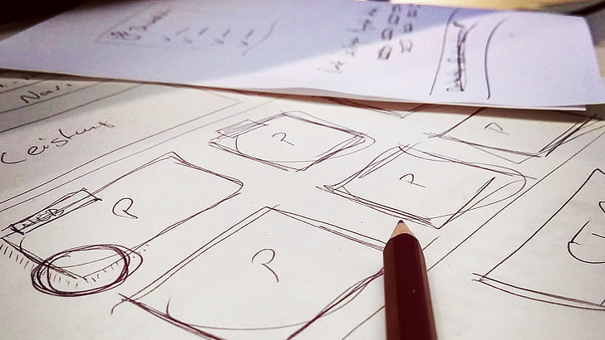
Mock-up Design

Slide 19

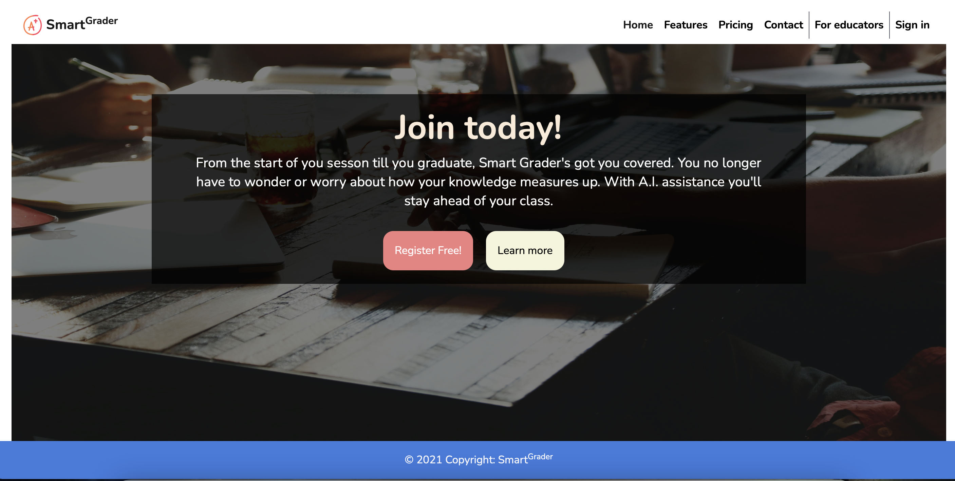
Homepage

Slide 20
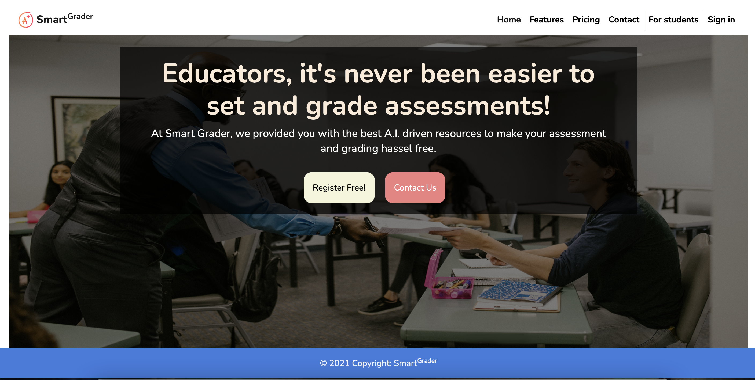
Homepage

Slide 21
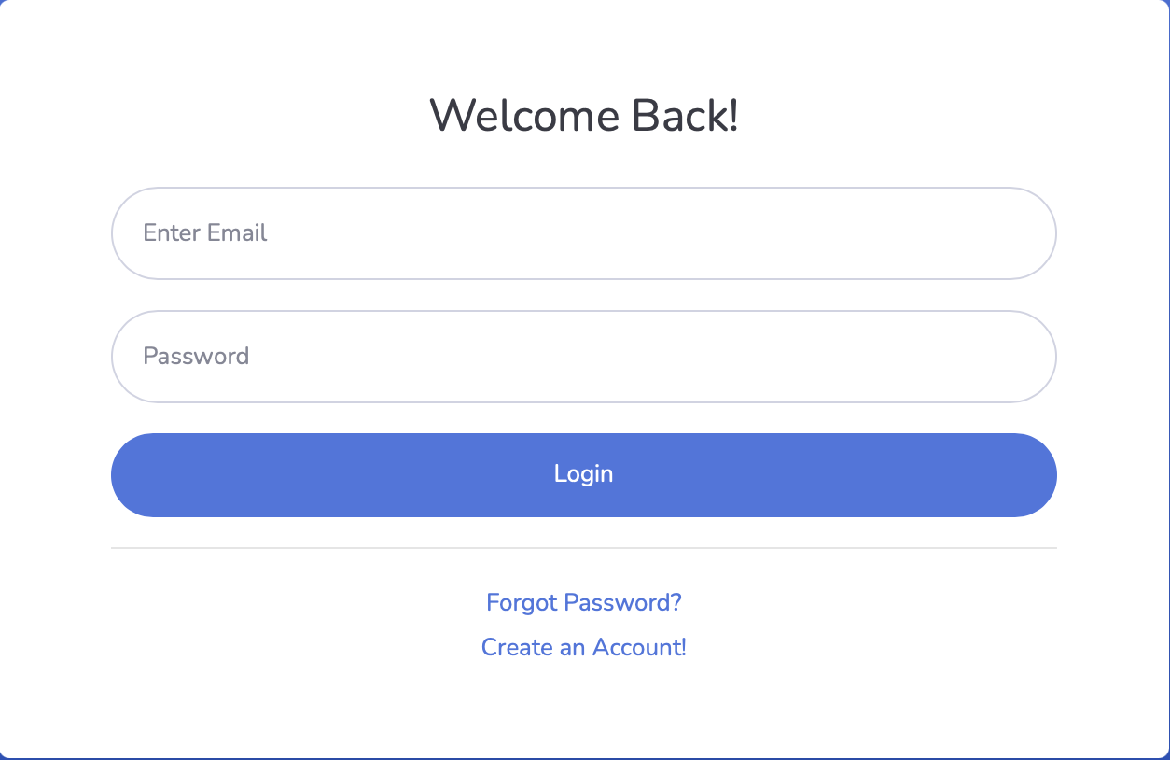
Homepage

Slide 22
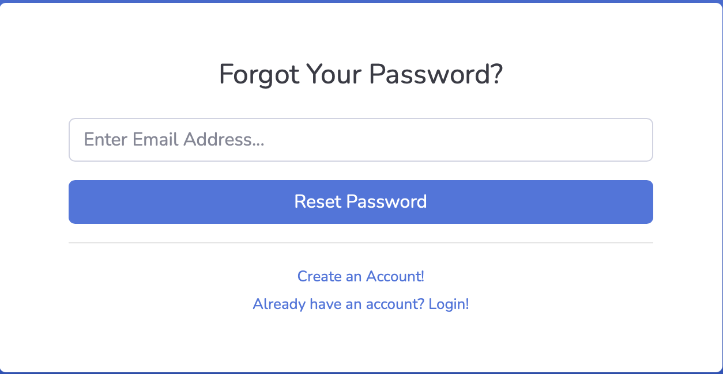
Homepage

Slide 23

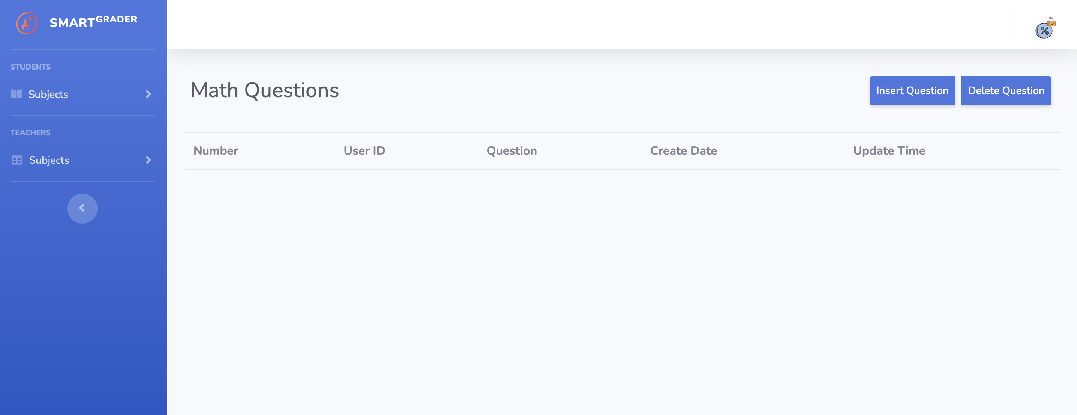
Upload page
This Photo by Unknown author is licensed under CC BY-NC.

Slide 24

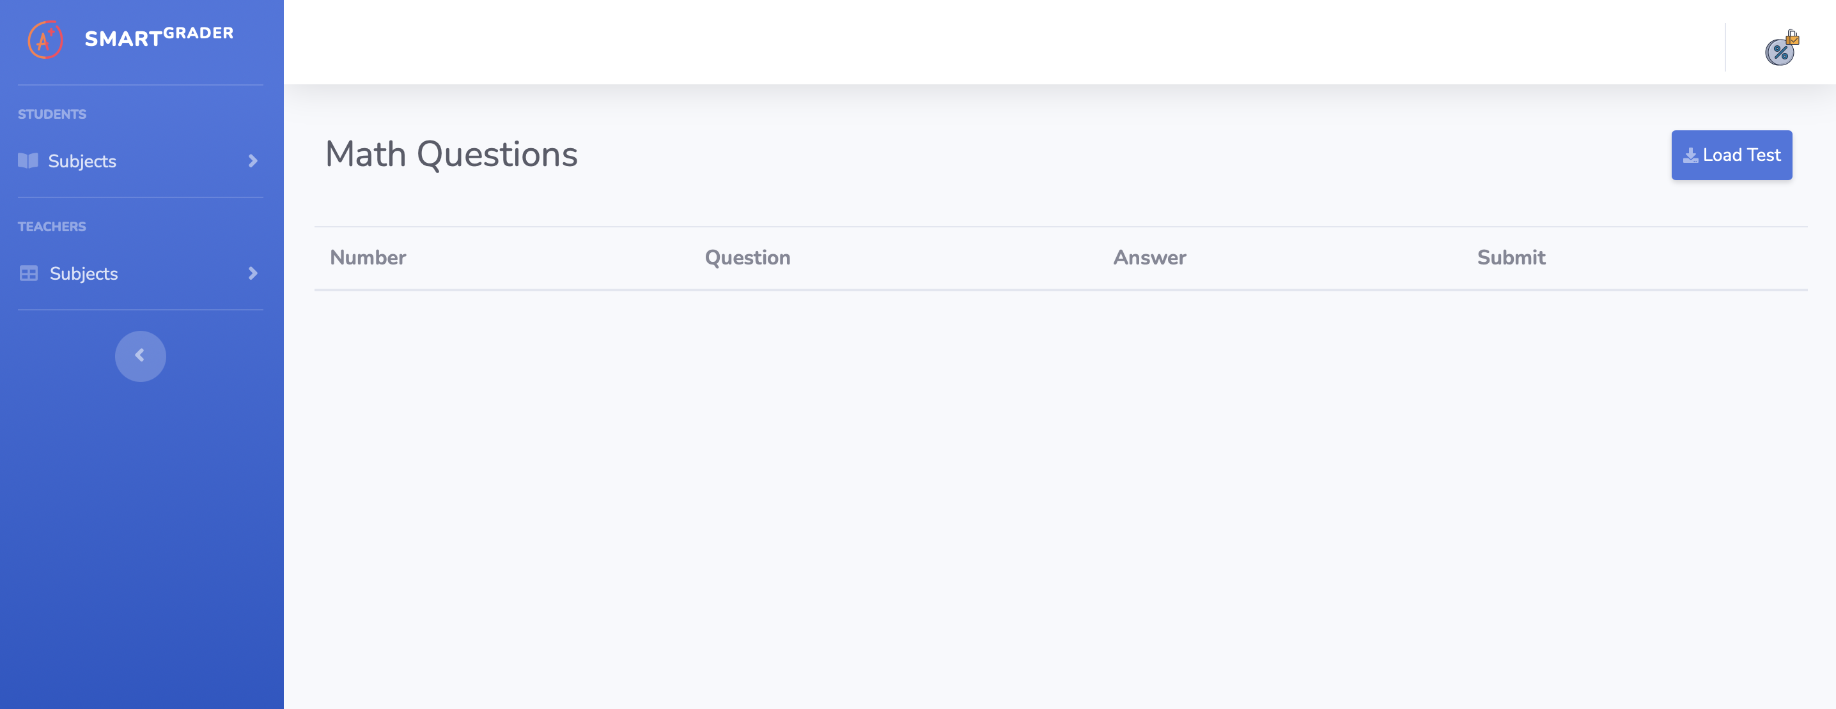
Assignment page

Slide 25

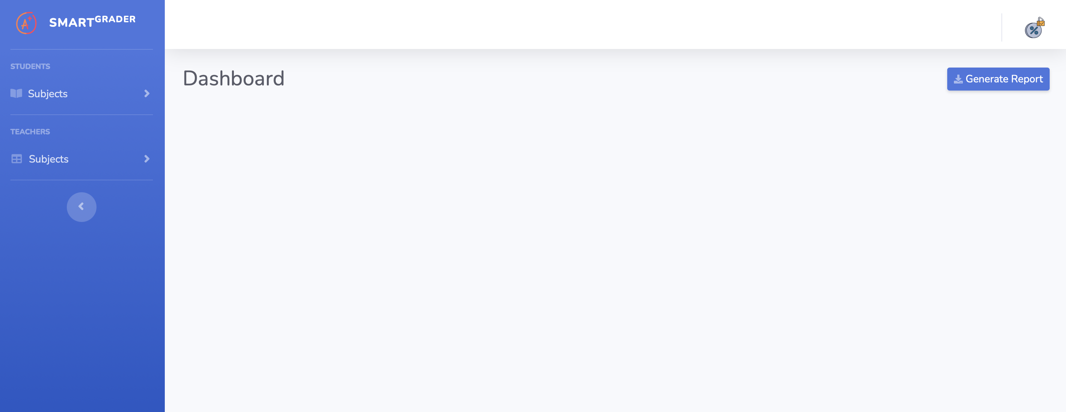
Final Page

Slide 26

Test cases

Slide 27

Test Cases for Homepage
TEST CASES | EXPECTED RESULTS
Browse the Website | Different types of users should be able to access the homepage of the website.
Create account on the Website | Users should be able to create accounts on the website to successfully log in to the website.
Forgot Password | Existing users should be able to reset their password using 'forgot password' option on the homepage of the website.

Slide 28
Test Cases for User Input Page
TEST CASES | EXPECTED RESULTS
Locate the upload file button | Teachers should locate the upload file button to upload the textbook pdf or notes to upload.
Choose the file show up | Teachers should find the choose the file option to upload the textbook or any text file of choice.
Drag and drop feature | Teachers should be able to drag and drop the file to upload.
Verify the uploaded file | Teachers should be able to verify the file that they have uploaded.
Submit the file | Teachers should find the submit button to finally upload the file

Slide 29
Test Casess for User Input Page
TEST CASES | EXPECTED RESULTS
Insert questions | Teachers should be able to find the 'insert question' button on the top right of the page to write in questions for the assignments.
Delete questions | Teachers should be able to verify and delete the questions if required.
Load Test | Students should be able to find the 'load test' button on the top right-hand side of the page.
Update | Students should be able to update their answers.
Take me to the text | Students should locate the 'take me to the text' button near the question, which will take them to the text where they can find the answers.

Slide 30

Test Casess for User Input Page
TEST CASES | EXPECTED RESULTS
Subject | Every user would be able to locate the 'subject' dropdown on the left-hand side of their page, which will display all the subjects for which they can get/create assignments.
Logout | Every user will find the logout option in the top right-hand side of the page to log out of the application.

Slide 31
Test Cases for Result Page
TEST CASES | EXPECTED RESULTS
Generate Report | Every user should be able to locate the 'generate report' option on the top right-hand side of the page to generate the report of any student.

Slide 32
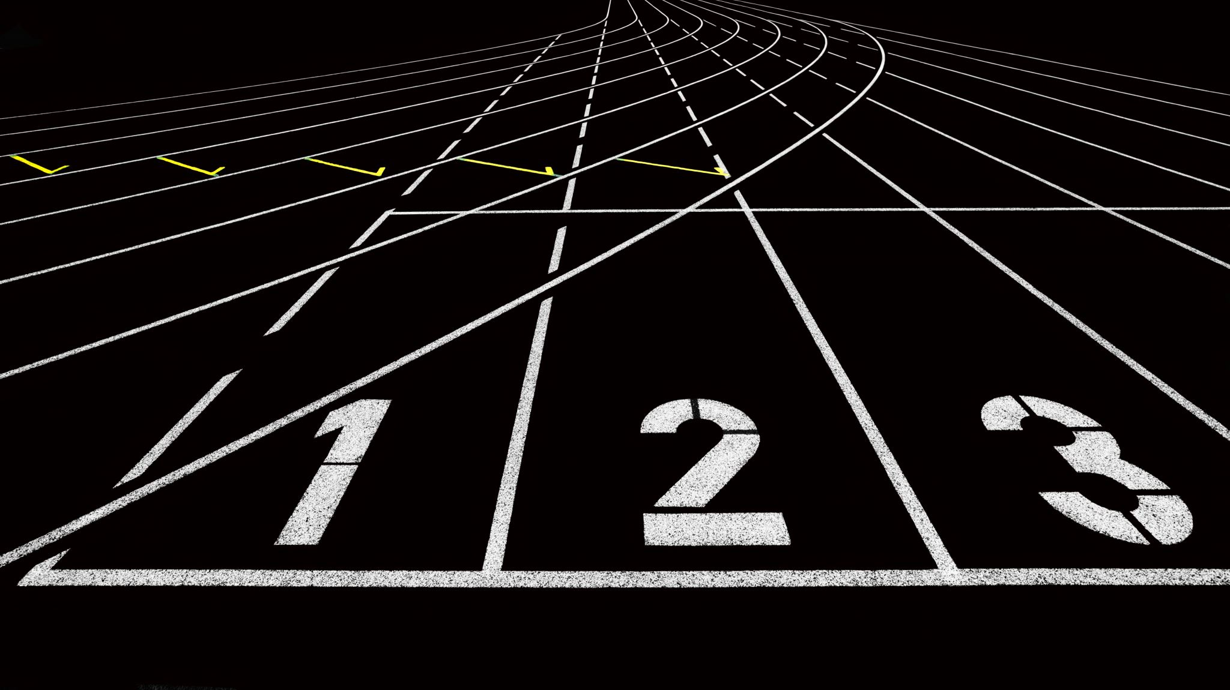
Sprint Backlog

Slide 33
SUMMARY OF THE ISSUE​ | ISSUE TYPE​ | PRIORITY​ | STATUS​ | ESTIMATED TIME​
Create mock-up designs | Task | Medium | Done | 3hr
Research and find the applications to implement in the project​ | Task​ | Medium​ | Done​ | 1week​
Create user stories​ | Task​ | Highest​ | Done​ | 2hr​
Complete Test cases​ | Task​ | High​ | Done​ | 2hr​
Research on google BERT for NLP (backend)​ | Task​ | Medium​ | Done​ | 1week​
Complete Acceptance criteria​ | Task​ | High​ | Done​ | 2hr​
Create Mock-up web design​ | Task​ | High​ | Done​ | 5hr​
Creating Deliverable 2 presentation​ | Task​ | Medium​ | Done​ | 1week​

Slide 34
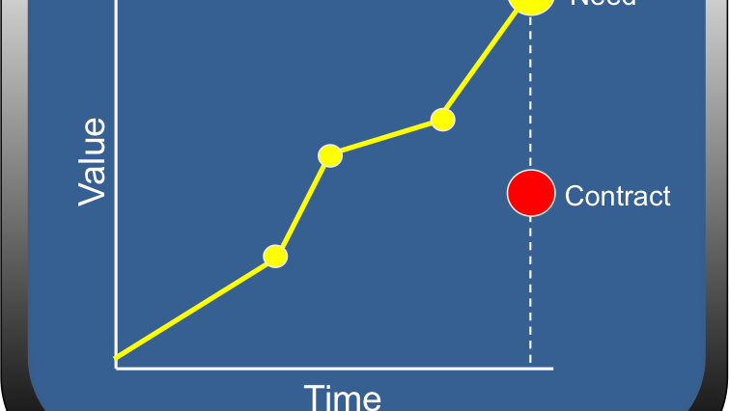
Product Backlog

Slide 35
SUMMARY | STATUS
As an educator I want to know if I have reached the correct page to use the Smart Grader application. | Done
As an educator I want to know if I have to use my school email to log in. | Done
As an educator I want to know what if I forget my password? | Done
As an educator I want to upload a textbook pdf for the students. | In Progress
As an educator I want I want to return to the homepage so that I can check the report of a student. | In Progress
As an educator I want to find the button to insert questions for the assignment. | Done
As an educator I want to find the button to delete questions for the assignment. | Done
As an educator I want to update the questions in the assignment. | Done
As a student I want to know if I have reached the correct page to use the Smart Grader application. | Done

Slide 36
SUMMARY | STATUS
As a student I would like to find my grades for the math assignment. | Done
As a student I want a button to load the test/assignment. | Done
As a student I would want to update my answers for the assignment. | Done
As a student I would like the app to guide me to the textbook where I would find the answers for my assignment. | In Progress
As a parent I want to know if I have reached the correct page to use the Smart Grader application. | In Progress
As a parent I want to find my daughter's report for the English assignment. | In Progress
As a head of math department at Pace University I want to know if I have reached the correct page to use the Smart Grader application. | In Progress
As a head of math department at Pace University I want to find the report for a student of my department. | In Progress

Slide 37
Milestone Timeline

Slide 38

Retrospective
What went well:
Scheduled time for team meeting with Zoom call.
Github was updated for the team.
One drive was updated with required documents.
Wiki Page for the team has been created.
What needs to be improved:
More team meetings has to be set up within individual teams.
What's next:
Set up time for more individual team meetings.

Slide 39

Future Tasks
What's next??
Ensure free flow of information by: 1. Connecting UI server outlets with corresponding server input channels. 2. Connecting Server outlets with corresponding UI input channels. 3. Checking all points of entry and exits to certify the proper connectivity.
Run use case scenario testing: 1. Provide all required input. 2. Wait and receive output. 3. Compare output with expectations. 4. If output fails to meet expectation, trace and fix the errors. 5. Repeat 1 – 4 until it meets expectations.

Slide 40

Conclusion
FOR MORE DETAILS ON SMART GRADER VISIT OUR GITHUB REPOSITORY:
https://github.com/joseph-dougal/CS691/
LINK TO OUR WIKI PAGE:
https://github.com/joseph-dougal/CS691/wiki

